Slide 1
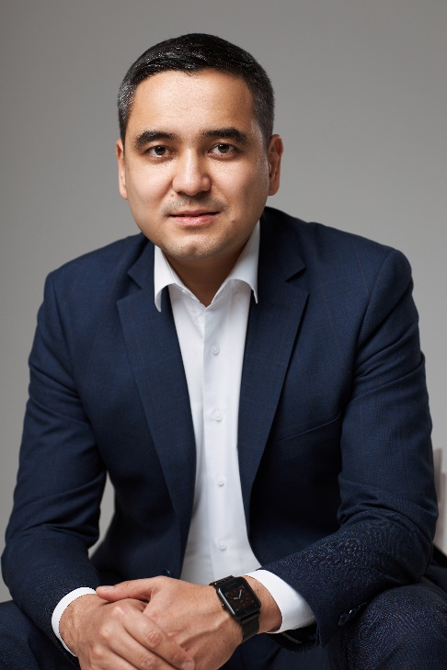
3rd CIS Islamic Banking and Finance Forum
Customer oriented insurance
&
Introduction of the new Project The first full-fledged Takaful Insurance company in Uzbekistan
Umid
Khudayberdiev
Hyatt Regency Hotel, Tashkent
March 14, 2023

Slide 2
We will talk about…
Insurance marketing facts: What about clients?
Insurance vs Customer
First Uzbek full-fledged Takaful company (project)
Mission and views. Partnership opportunities.

Slide 3
Republic of Uzbekistan
Fast growing economy in Central Asia
The largest population in region - 35M+ people
95% of population are Muslims
The historical land of Burhoniddin al-Marginoniy, Imam al-Moturidiy, Imam at-Termiziy and Imam al-Bukhari
New political course open to business and also financial services sector

Slide 4
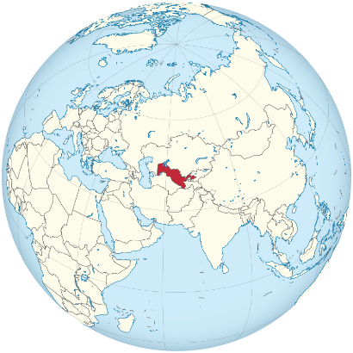
Infrostructure of the national insurance market
Supervisory board Ministry of finance
Fund for Guaranteeing Payments for Compulsory third partie motor insurance
ASSOCIATION of Professional Participants of the Insurance Market
Insurers (42): - General (34) - Life (8)
Actuaries (5)
Insurance brokers (5)
Assistants, adjusters and surveyors (22)

Slide 5
Numbers of insurance industry
Insurance companies:
Life – 8
Non-life – 34 Insurance brokers – 5
Insurance agents – 9 100
Insurance professionals – 4 200
Insurance premiums share in GDP – 0,72%

Slide 6
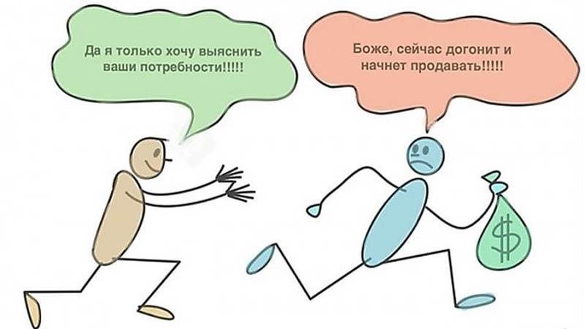
Marketing
Sir, I just want to know your needs!!!!
Oh God, want to catch up, and sell smth!!!!

Slide 7
Marketing
Страхование — это классическая «скучная категория», где выбор делается не покупателем, а ЗА покупателя.
Даже больше, во многих случаях, покупатель и застрахованный — это разные люди.
Поэтому Маркетинг и брендинг в этих категориях — это крайне сложный̆ инструмент, который̆ раскрывает свою силу не сам по себе, а благодаря коммуникациям.
Проще говоря, не так важно позиционирование, как работа с ним, его «раскрытие» в различных каналах коммуникации.

Slide 8
What about clients?
История клиенто-ориентированности
Период | Что было сделано для клиентов | Мотив
1991-2003 | Формирование начальной законодательной базы | Защита
2008 | Внедрение ОСАГО как инструмента кросс продаж (КАСКО) | Защита
2008-2009 | Внедрение ОСГОР как инструмента кросс продаж (НС, ДМС) | Защита
2014-2022 | Страхование жизни с налоговой льготой (практика прекращена) | Льгота

Slide 9
Состояние рынка
Продукт | Состояние, источник | Охват
КАСКО (авто) | Отсутствие сервиса, плохой охват | больше B2B
ДМС (мед.) | Отказ от рынка физлиц, слабый сервис, сложные условия страхования | крупные B2B
Имущество | В основном тендеры и залоги | В основном B2B
Другие виды | TRAVEL, ОСАГО, СМР, залоги, НС, другие | Вменяются клиентам или обзятельные

Slide 10
Market structure by products in comparison with CIS markets
Uzbekistan (2021)
Post Soviet-Union Countries (CIS)
(13 countries)
Loan risk insurance
Property insurance
Medical and accident insurance
Comprehensive motor insurance
Other products
Comprehensive Motor insurance
8,5%
Commercial general liability
Commercial general liability
Medical and accident insurance
Property insurance
Loan risk insurance
Transport risks
Cargo
Other products
1,2%
0,8%

Slide 11
Digital first: insurance
Страхование – собирать у многих и платить малым!
Много! Масштабирование и максимальный охват рынка возможен только через IT технологии.

Slide 12
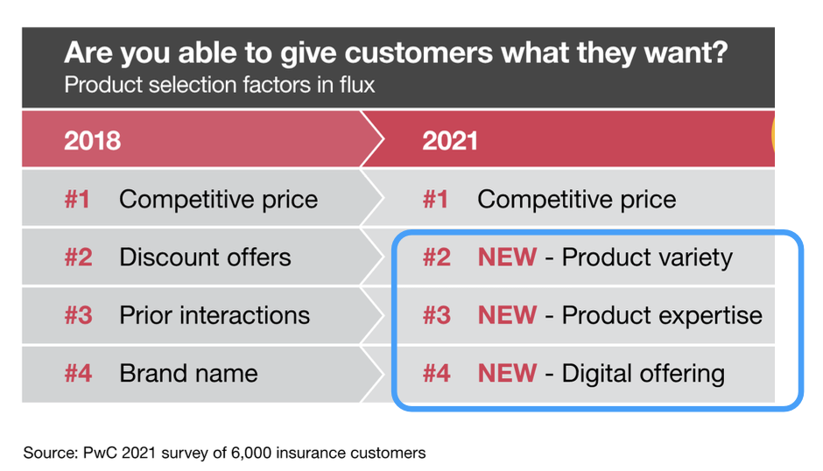
Customer wants changes after pandemic

Slide 13
Churn rate или почему люди не любят страховщиков
1. Страховщики скупы на диалог и сервис. Нет коммуникации (забрал премию и убежал)
Покупка полиса
Продление полиса
Продление полиса
2. Страховщики говорят о неприятных вещах – смерть, ДТП, пожар, землетрясение, банкротство
3. Уравниловка. Почему я должен платить как все? Почему моя страховая премия сгорает, за что?

Slide 14
TAKAFUL practices in Uzbekistan
From 2021 Conventional insurance company - Apex insurance started Takaful Window
Brand name – Apex Takaful
Insurance Portfolio structure
Motor insurance – 70%
Travel insurance – 28%
Others – 2%

Slide 15
TAKAFUL practices in Uzbekistan
O’zARO – public Islamic insurance society.
Offers wide range of Islamic financial services such as motor, public mutual insurance, mortgage and so.
Insurance marketing instrument and sales developed conservatively
Now refocuses on consulting services on Islamic finance and education

Slide 16
TAKAFUL practices in Uzbekistan
Development Problems (Challenges and Issues):
Apex Takaful enters the market without certain marketing strategy. Didn’t continue started dialogue
Clients have doubts to Islamic Window model in the borders of Conventional insurance company
O’zARO has difficulties - because people have doubts to rely on the company without license.
There is no legislation background, lack of investment instrument
Poor financial and insurance knowledge (culture)
Islamic banking environment not developed yet

Slide 17
TAKAFUL practices in Uzbekistan
Development Benefits:
Mostly Muslim population – 95%
Young population –– 70% (15-64 age group)
Conventional insurance covers mostly B2B and compulsory fields
Individuals market almost free
Businesses have demand to Halal investment
The Government is planning to adopt the declaration that can open path to Takaful and Islamic investment

Slide 18
The FIRST Uzbek full-fledged TAKAFUL Company (project)
Project Started from 2022
Strategy
Planning to Build Takaful company on the basis of General insurance license, using mostly Waqf model.
Marketing
Analyzing market, build communication and brand strategy, conducting surveys, focus on individuals
Digital
IT base company with all instruments
Sharia standards
We have our local consulting partner
Also we are negotiating with AlHuda CIBE on Takaful consulting

Slide 19
The FIRST Uzbek full-fledged TAKAFUL Company (project)
Media
We have own Media company that have 80% coverage of media and advertisement market. We have up to 70% discount form media tarif.
We own SMM team, with audience more than 14M followers. 50K followers per celebrity or influencer.
Our CRM base counts more than 1M warm lids
Sales
We are designing sales strategy on online sales and through well educated and structured call-center
B2B – we are preparing team for corporate sales

Slide 20
Mission and background
Mission: Hoping the blessing of Allah to be the first to provide the comprehensive Takaful solution to Uzbek society. (Fard al-Kifayah)
Background:
19 years of experience in insurance, inc..
2 years – Insurance Supervisory Board
10 years – Top management
Tight networking among insurance professionals

Slide 21
Partnership opportunities
At this point of advancement of our product we came to idea that we have not enough experience in Takaful
Now we are open to partnership with International Takaful operator with best experience
We see partnership through investment
We are ready to provide all necessary information to our future partners
Welcome to Uzbekistan!!!

Slide 22
Thank you for your attention!

